Slide 1
ANSWERS
Zombie Escape Room

Slide 2
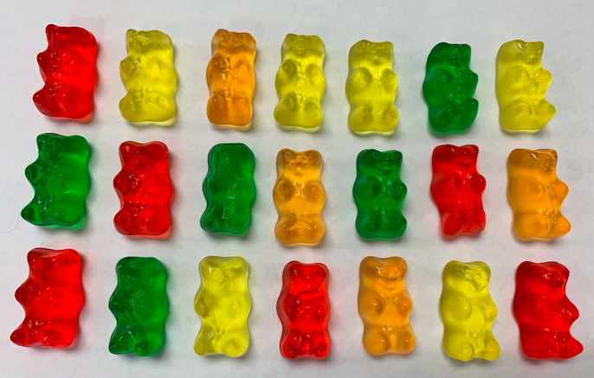
Puzzle Number 1 - Observation
“quantitative yellow, quantitative orange, quantitative green, quantitative red.”
6456

Slide 3
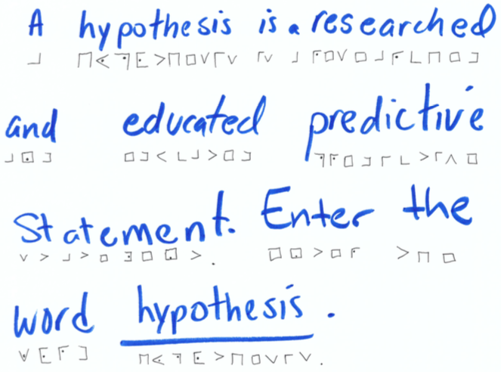
Puzzle Number 2 - hypothesis
HYPOTHESIS

Slide 4
Puzzle Number 3 – Data Collection
1. The zombie walked with a limp. _I__
2. The runner was running away from the zombie. _I__
3. Reptiles can be found in the pond. _O__
4. The zombie has 2 legs. _O__
5. The zombie can’t swim and will drown if it falls in the water. _I__
6. There is one zombie. _O__
7. The pond water is cool. _I__
8. There are aquatic plants in the pond. _O__
9. What kind of data does question 4 use? _A__
10. What kind of data does question 8 use? __B_
IIOOIOIOAB

Slide 5
Puzzle Number 4 – Representing data
BLBBBLLL

Slide 6
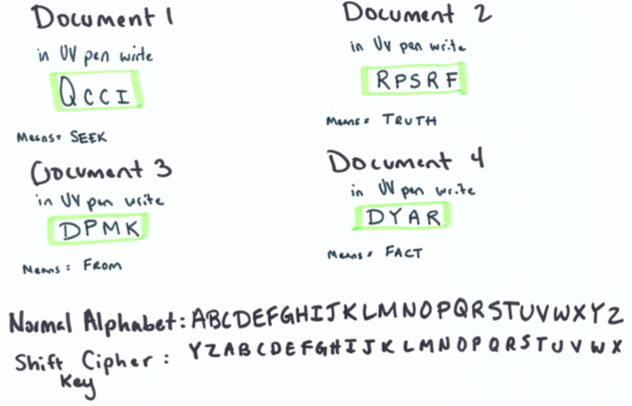
Puzzle Number 5 – Analyzing
SEEKTRUTHFROMFACT

Slide 7
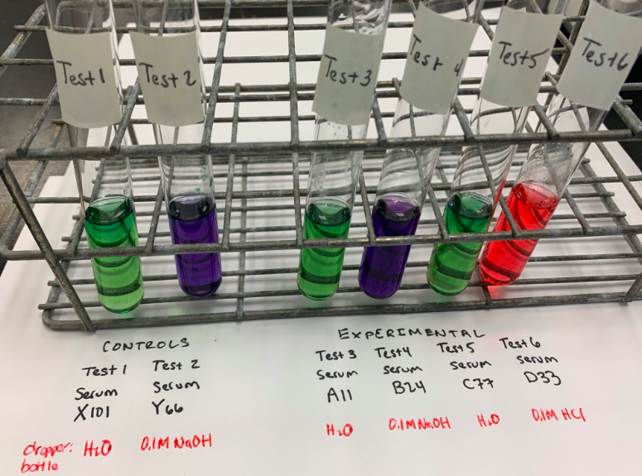
Puzzle Number 6 – Experimenting
D33

