Slide 1
Do Now: What does a scientist look like?
Sketch your idea on a piece of paper (2 min)
Think-pair-share: Discuss your drawing with a person sitting next to you. Are there any patterns that came up in these drawings? (2 min)

Slide 2
Load the website: https://www.500queerscientists.com/
Scroll down: Look at what real scientists look like: backgrounds, cultural, size, age, gender, color self-identify is all different.
The fact that these humans are willing to share their stories is important. This is especially true when a survey found more than 40% of LGBTQ+ identified people working in STEM fields are not out to their colleagues (Yoder & Mattheis, 2016).
With that said: Today, we’re going to dig deeper with a new focus. This focus will be about the scientific method. In fact, the man given credit for discovering the scientific method, Francis Bacon, was part of LGBTQ+ community as well.
Reference: Yoder, J. & Mattheis, A. (2016). Queer in STEM: Workplace experiences reported in a national survey of LGBTQA individuals in science, technology, engineering, and mathematics careers. Journal of Homosexuality, 63:1, 1–27, DOI: 10.1080/00918369.2015.1078632

Slide 3
Zombie Escape Room
The fate of the world is in your hands!
LINK:
https://forms.gle/q4b5fd6UytNRoCqa9

Slide 4
Model – Cipher Puzzle
Numbers can be used as a numerical/visual/symbol representation. For example A = 1
A B C D E F G H I J K L M N O P Q R S T U V W X Y Z

Slide 5
Model – Cipher Puzzle
Numbers can be used as a numerical/visual/symbol representation. For example A = 1
A B C D E F G H I J K L M N O P Q R S T U V W X Y Z
1 2 3 4 5 6 7 8 9 10 11 12 13 14 15 16 17 18 19 20 21 22 23 24 25 26

Slide 6
Guided Practice – Try the Cipher
Francis Bacon has been attributed with the discovery of the scientific method. What is a quote is also attributed to him:
___ ___ ___ ___ ___ ___ ___ ___ ___ ___ ___ ___ ___
23 9 20 8 11 14 15 23 12 5 4 7 5
___ ___ ___ ___ ___ ___ ___ ___ ___ ___
3 15 13 5 19 16 15 23 5 18

Slide 7
Guided Practice – Try the Cipher
Francis Bacon has been attributed with the discovery of the scientific method. What is a quote is attributed to him:
___ ___ ___ ___ ___ ___ ___ ___ ___ ___ ___ ___ ___
23 9 20 8 11 14 15 23 12 5 4 7 5
___ ___ ___ ___ ___ ___ ___ ___ ___ ___
3 15 13 5 19 16 15 23 5 18
W I T H
K N O W L E D G E
C O M E S
P O W E R

Slide 8
Independent Practice
Attention Lab Corps Employees. The Zombie infection that is sweeping though the state has reached our company doors. We are in full lock down mode. None of us will be able to escape unless we crack the 6 security protocols to overcome the lockdown. Our lab doors will not open until we have gone through all the stages of the scientific method and cracked the puzzles at each station.

Slide 9
Puzzle Number 1 - Observation
Science uses the systematic approach of the scientific method to logically gather empirical evidence. This empirical evidence is gathered as data. Data are collected by observations or experimentation.
For this puzzle your lab group must collect quantitative observations about the patters that are taking place. When you have cracked the code, your answer must be written in the form of “quantitative yellow, quantitative orange, quantitative green, quantitative red.” Leave no spaces in your google form answer.

Slide 10
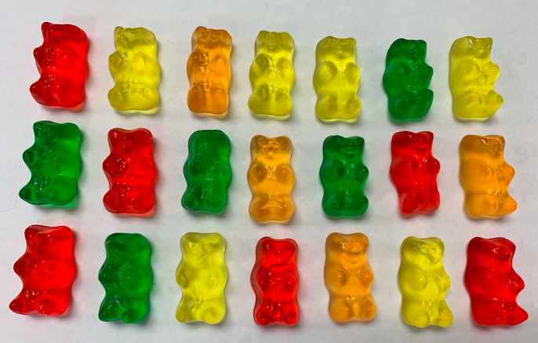
“quantitative yellow, quantitative orange, quantitative green, quantitative red”

Slide 11
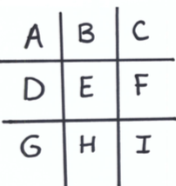
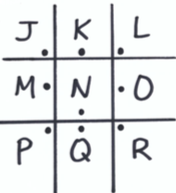


Puzzle Number 2 - hypothesis
Once you have observed something - asking good questions is very important in the inquiry process.
For this next puzzle, use the Pigpen Cipher below to decode the statement. The cipher will tell you what word to enter into the google form. Make sure to use capital letters only.

Slide 12
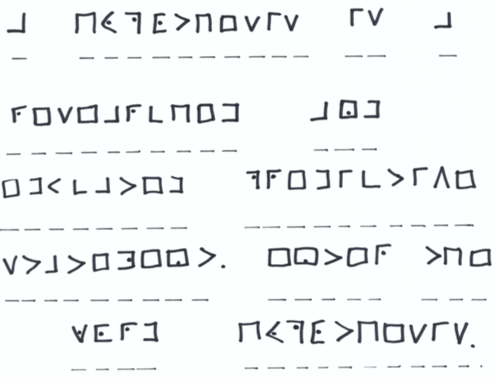
Pigpen Code To Crack:

Slide 13
Puzzle Number 3 – Data Collection
Normally in the scientific method you would set up an experiment at this point – but lets make sure we understand ideas first and we can circle back to this later.
Observation Versus Inference Statements
Observations are events you observe by using senses (touch, sight, taste, sound, smell, etc.) to gather facts. These are used to qualitatively describe or measure using facts.
Inference is the connections you might make because of those events, and can be used to explain something.
Quantitative Versus Qualitative Data
Quantitative data are represented with numbers
Qualitative data are descriptive.

Slide 14
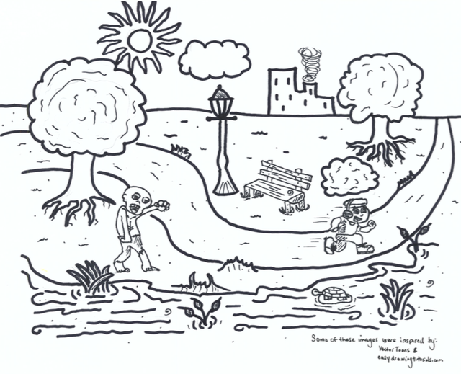
To unlock this puzzle and move forward, your group must look at the image provided and answer the questions on the next page.

Slide 15
For 1-8: Write “O” for statements that are observations and “I” for statements that are inference.
For 9-10: Write “A” for Quantitative and “B” for Qualitative data.
On the google form make sure to answer the questions in order and make sure to capitalize the letters when entering them. Leave no spaces!
1. The zombie walked with a limp. ___
2. The runner was running away from the zombie. ___
3. Reptiles can be found in the pond. ___
4. The zombie has 2 legs. ___
5. The zombie can’t swim and will drown if it falls in the water. ___
6. There is one zombie. ___
7. The pond water is cool. ___
8. There are aquatic plants in the pond. ___
9. What kind of data does question 4 use? ___
10. What kind of data does question 8 use? ___

Slide 16
Puzzle Number 4 – Representing data
A line graph, is used to visualize the value of same thing with a range of options or something over time.
A bar graph, is used to compare different set or categories of data.
Look at the following data examples. Choose whether the best representation of the data would be a line graph or a bar graph.
For a line graph use the capital letter L. For a bar graph use the capital letter B. Put these in numerical order, use capital lettering, without spaces in the google form.

Slide 17
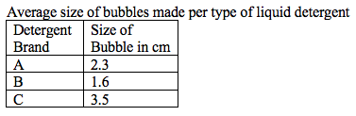
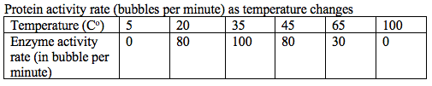
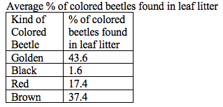

1.
2.
3.
4.

Slide 18
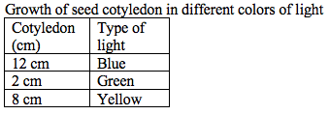



5.
6.
7.
8.

Slide 19
Keep Track of Your Answers
1: _______________
2: _______________
3: _______________
4: _______________
5: _______________
6: _______________
7: _______________
8: _______________

Slide 20
Puzzle Number 5 – Analyzing
In this part of the scientific method we need to review ideas and draw conclusions.
Based on a colleague’s previous work, we know Zombies do not see in the same electromagnetic spectrum that we do. Their ocular neurons pick up only ultraviolet light. One of our top scientists was studying this concept. They were so inspired by this finding that they wrote all their notes in UV pen and in code. Unfortunately they were bitten by an infected zombie. Use the UV pens to find their hidden message to de-code the wisdom in their last secrete message to the lab.
The code is written in a shift cipher around the room. This is a monoalphebeitc substitution where you shift all the letters over by 2 letters. This means a normal letter C would be an A in the code.

Slide 21
Use the space below to help you make the shift cipher
A B C D E F G H I J K L M N O P Q R S T U V W X Y Z
Find the 4 documents in the room, and read their codes using the UV pen in sequential order. Once you discover your message type this into the google doc in all capital letters and with no spaces
Document 1 =
Document 2 =
Document 3 =
Document 4 =

Slide 22
Document 1 =

Slide 23
Document 2 =

Slide 24
Document 3 =

Slide 25
Document 4 =

Slide 26
Puzzle Number 6 – Experimenting
This is the stage where you have made your observations, you have made a hypothesis. Now we are familiar with data collection and analyzing concepts. Now we need to test out your ideas in the form of an experiment.
In the midst of the zombie outbreak, thousands of serums have been tested by Lab Corp. to find a potential serum to cure the infection. First, your group must test 2 different control groups (Serum X101 and Serum Y66). These are serums that have already been tested and have no positive effect on curing the zombie blood. These will be used as standards of comparison when testing the last 4 potential experimental serums.
The green zombie blood is in the test tubes to start. Your groups must test the serums in order. Each person must put on their googles as the serums are tested. The hope is that one of these serums will be a cure. If you get a positive result for the serum working, the green zombie blood will revert back to red, normal blood.

Slide 27
If your group discovers a serum that works, type in the capital letter and the number of the serum that works into the google form. Do not leave blanks. For example: H76
Add 5 drops of each serum and observe the result.
Observations:
Test 1: Control Group Serum X101
Test 2: Control Group Serum Y66
Test 3: Experimental Serum A11
Test 4: Experimental Serum B24
Test 5: Experimental Serum C77
Test 6: Experimental Serum D33

Slide 28
Try Your Hand at Creating a Puzzle
Goal: Your Group Task is to pick one of the scientific method steps and design one escape room puzzle for this topic. Be as creative as possible.
Let your teacher know what potential materials your group might need.
See the rubric on the other page.

Slide 29
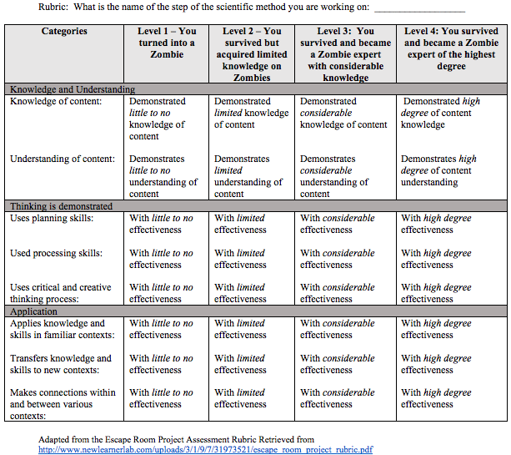

Slide 30
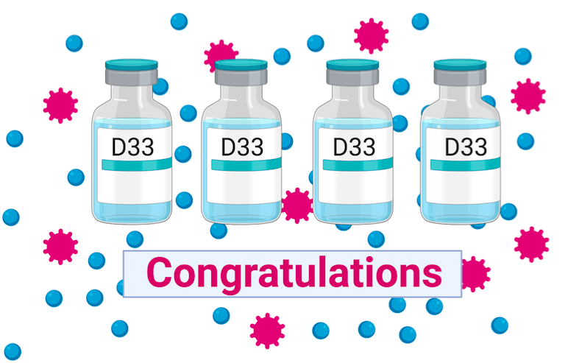
You Saved the World!

Slide 31
Collect formative evidence:
Your Ticket-Out-The-Door
Please write:
2 things you learned & 1 thing you still need help with

